Slide 1



WELCOME TO
OUR CLASS

Slide 2

REVIEW
What do you usually do
at recess?

Slide 3

study
skip rope
listen to music
talk
Activities
at recess
play soccer
play games
read
play volleyball

Slide 4

Unit 5
WORK AND PLAY
B- It’s time for recess
Lesson 5: B3,B4

Slide 5
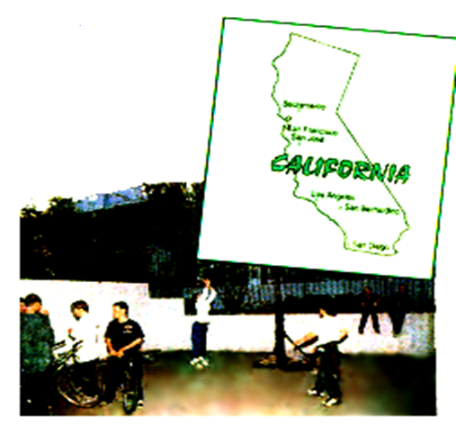
Question:
What do students in American schools do at recess?

Slide 6

B3. New words:
- junior high school (n) : trường trung học
- energetic (a): hiếu động
- whole (a): trọn vẹn
- portable (a): có thể xách tay
- CD player(n): máy nghe CD
- common (a): phổ biến
- relax (v): thư giản
- cards (n): thẻ
- mostly(adv): hầu hết
- worldwide(a): khắp thế giới

Slide 7
- to take part in: tham gia
to practice: thực hành
to score a goal: ghi bàn
to swap baseball cards with: trao đổi thẻ với

Slide 8
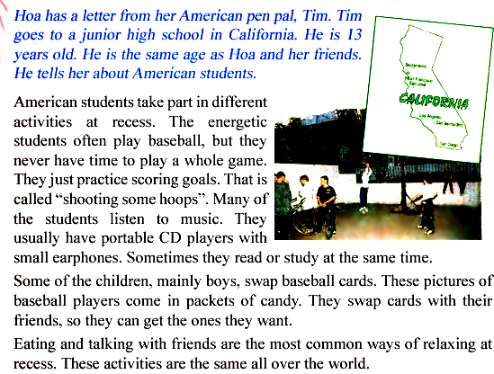
3 Read. Then answer the questions

Slide 9
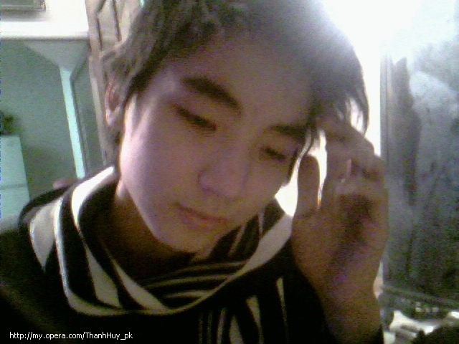
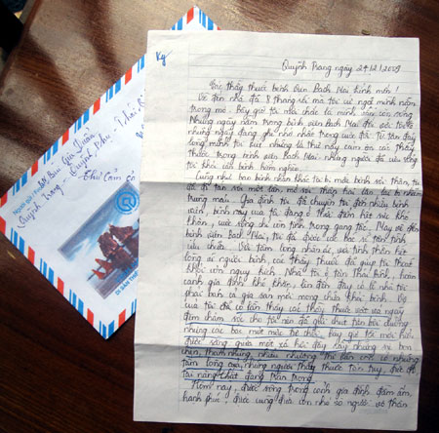
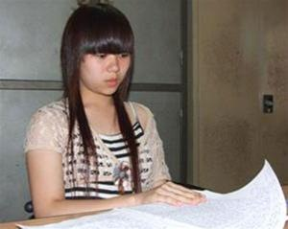
II. READ:
Tim
Hoa

Slide 10
True or false prediction:
T | F
I. True or false :
1. The energetic students in American often play basketball at recess.
V
2. They don’t listen to music.
X
3. Boys and girls swap baseball cards.
X
4. They usually eat and talk to each other at recess.
V

Slide 11
Complete the sentences
a. Hoa’s pen pal Tim goes to …………
A. Hoa’s school.
B. a school in Viet Nam.
C. an American school.
D. a senior high school.
b. “ ... they never have time to play a whole game.” This means recess is………..
A. short.
B. boring.
C. energetic.
D. long.
c. Baseball cards are popular with ……….
A. everyone.
B. only girls.
C. only boys.
D. mostly boys
d. Eating and talking with friends are popular activities ……………
A. in America.
B. in Viet Nam.
C. in a few countries.
D. worldwide.

Slide 12
5
4
3
1
0
2
CHOOSE THE BEST ANSWER
Hoa’s pen pal Tim goes to
…………
⬧
A
Hoa’s school.
B
a school in Viet Nam.
C
an American school.
D
a senior high school.
Notes:
12

Slide 13
5
4
3
1
0
2
CHOOSE THE BEST ANSWER
b. “ ... they never have time to play a
whole game.” This means recess is
………..
⬧
A
short.
B
boring.
C
energetic.
D
long.
Notes:
13

Slide 14
5
4
3
1
0
2
CHOOSE THE BEST ANSWER
c. Baseball cards are popular with ……….
⬧
A
everyone.
B
only girls.
C
only boys.
D
mostly boys
Notes:
14

Slide 15
5
4
3
1
0
2
CHOOSE THE BEST ANSWER
d. Eating and talking with friends are
popular activities ……………
⬧
A
in America.
B
in Viet Nam.
C
in a few countries.
D
worldwide.
Notes:
15

Slide 16
Post - reading
Discussion :
What do students in American
schools do at recess?
→They usually…………………..
play catch
Adverbs: never, sometimes, often, usually, …

Slide 17
listen to music
play baseball
practice scoring goal
What do students in American
schools do at recess?
talking
eating
swap baseball cards
read or study

Slide 18

Lucky number
1
8
2
7
3
6
4
5

Slide 19

III. Homework
Learn by heart the new words
Prepare new lesson:
Unit 6: After school, A1, 2

Slide 20


Slide 21
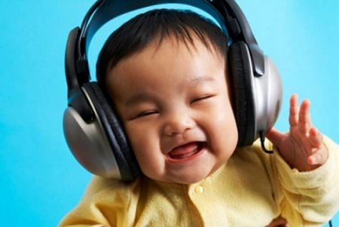
Number 1

Slide 22
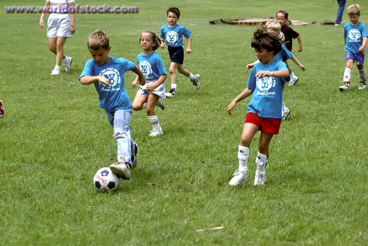
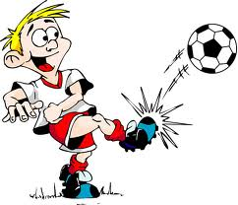
Number 2

Slide 23
Number 3 is a lucky number
Congratulations!

Slide 24
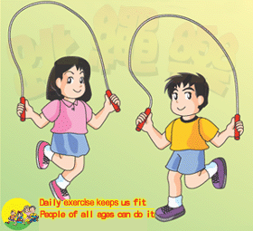
Number 4

Slide 25
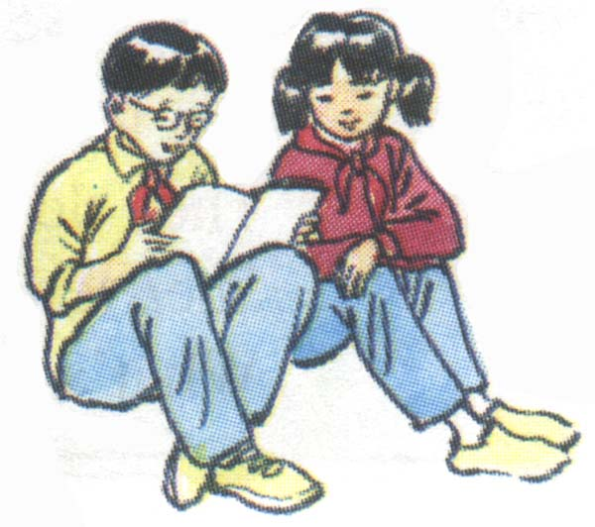
Number 5

Slide 26
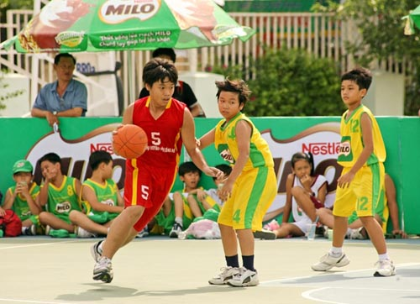
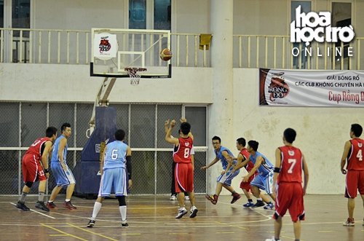
Number 6

Slide 27
Number 7 is a lucky number
Congratulations!

Slide 28
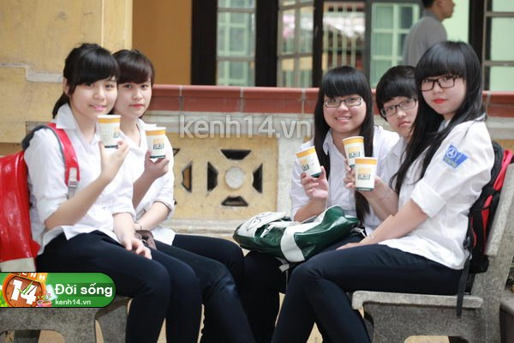
Number 8

